Slide 1




SMART INDIA HACKATHON 2026
  Problem Statement ID – SIH26102
  Problem Statement Title- Development of an AI-powered system to detect anomalies, fraud, and inefficiencies in MPLAD Scheme implementation regd.
  Theme- Smart Automation
  PS Category- Software
  Team ID- A3CC90
  Team Name - MetaMinds_404

Slide 2

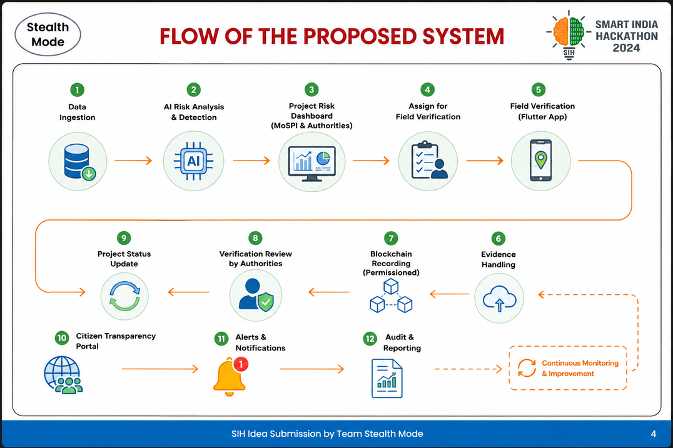
MPLADSentinel
MetaMinds_404
Proposed Solution
Flow of the proposed system
Government Intelligence Web Portal
Field Officer Mobile App
  Unified MPLADS project dashboard
  AI-based risk scoring with explanations
  Financial anomaly & expenditure analysis
  Progress–expenditure mismatch detection
  Cost benchmarking
  Delayed project prediction
  Fund-utilisation analytics & grounded AI assistant
  Assigned project verification
  GPS-based site verification
  Physical progress recording
  Geo-tagged photos.
  Officer remarks & observations
  Configurable evidence-photo count per inspection
Trusted Evidence & Audit Layer
Citizen Transparency Portal
  IPFS-based evidence storage
  Permissioned Hyperledger Fabric ledger
  Important project event recording
  Role-based approvals
  Tamper-evident audit history
  Ledger-backed integrity verification
  Live IPFS/Pinata evidence retrieval in the audit trail
  Search MPLADS projects
  View public project information
  View project status & progress
  View sanctioned/expenditure information
  Public record integrity verification
  View permitted project history
  Submit grievances
How it addresses the problem?
  Detects financial & project anomalies using AI
  Identifies high-risk projects for timely action
  Enables ground-level progress verification
  Reduces manual monitoring effort
  Ensures tamper-evident project records
  Strengthens accountability across authorities
  Improves transparency for citizens
  Answers instant queries through a grounded AI assistant
Team MetaMinds_404
2

Slide 3
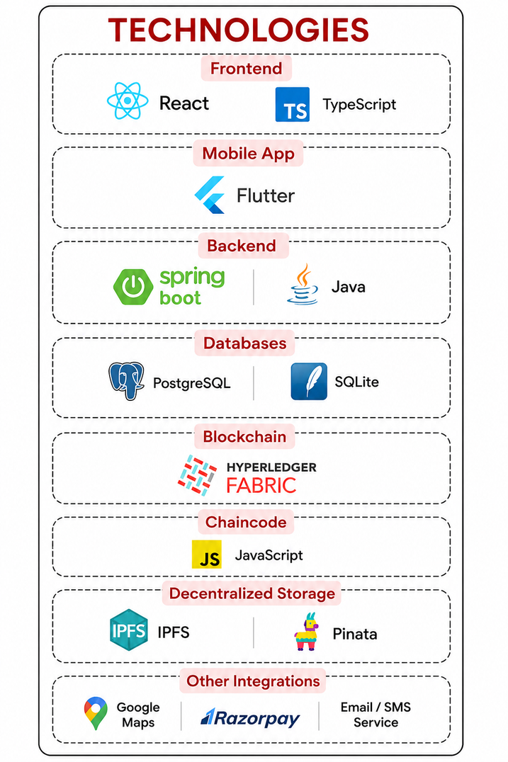
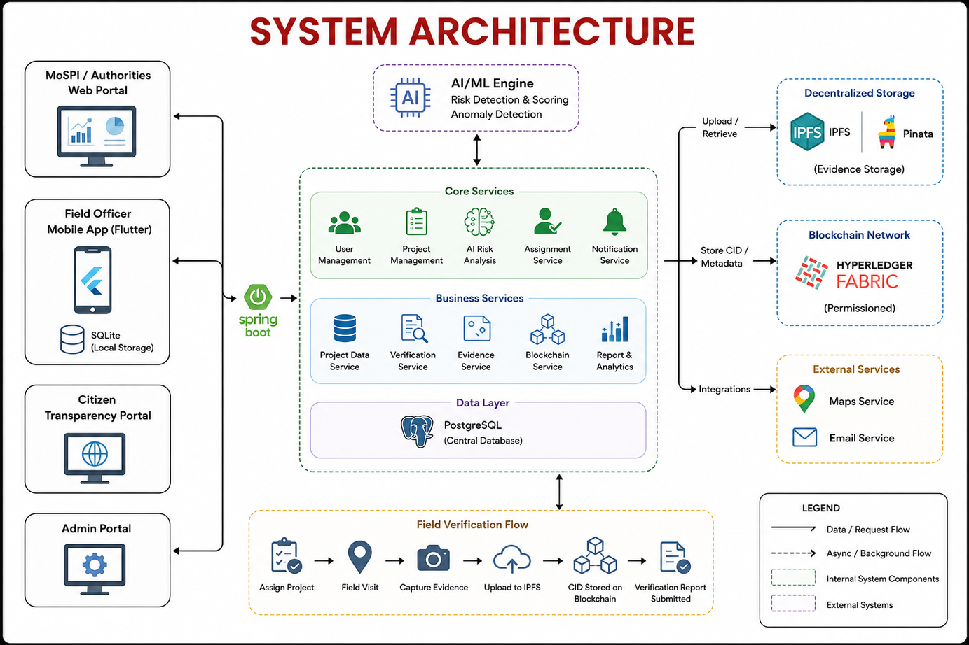
TECHNICAL APPROACH
MetaMinds_404
TECHNOLOGIES
PROPOSED ARCHITECTURE
Frontend
React 19 · TypeScript · Vite
Backend
Spring Boot 3 · PostgreSQL · Flyway
Evidence Layer
IPFS / Pinata (live)
Mobile
Flutter — camera, GPS, EXIF geotag
Planned
Hyperledger Fabric · Python AI microservice
Methodology & Process Flow
1. Ingest MPLADS work & payment data
2. Normalize & de-duplicate records
3. Weighted statistical risk scoring
4. Assign field inspection to an officer
5. Flutter capture — GPS + EXIF geotag
6. Evidence pinned to IPFS
7. Immutable audit trail (Fabric — planned)
LIVE IN PROTOTYPE
Weighted explainable risk model
Grounded AI assistant
Fund-utilisation analytics
Live IPFS evidence fetch · RBAC
ARCHITECTED — NEXT MILESTONE
Vendor/entity cartel graph (HHI)
Photo forensics: dHash duplicate + ELA tamper check
Multi-source GPS spoofing defense
Fabric anchoring · escrow-style fund gating
Team MetaMinds_404
3

Slide 4





FEASIBILITY AND VIABILITY
MetaMinds_404
FEASIBILITY
POTENTIAL CHALLENGES
STRATEGIES TO OVERCOME
Existing MPLADS Data:
Uses available MPLADS project, sanction, expenditure and progress data for AI-driven analysis.
AI False Positives
Legitimate variations in expenditure or project progress may sometimes appear as anomalies.
Explainable risk scores with human in the loop validation
Scalable AI Analytics:
ML and rule-based models can analyse large volumes of projects and generate risk scores.
Blockchain Scalability
Large inspection photographs and evidence files are impractical for direct on-chain storage.
IPFS-based evidence storage with CID-linked blockchain records
Mobile Field Verification:
Flutter-based mobile app enables officers to verify project status and submit structured evidence.
Secure Digital Infrastructure:
IPFS and a permissioned Hyperledger Fabric network can provide secure evidence storage and an auditable project history.
Multi-Authority Coordination
Different MPLADS stakeholders require controlled access according to their roles and responsibilities.
Permissioned blockchain with role based access management
Team MetaMinds_404
4

Slide 5




IMPACT AND BENEFITS
MetaMinds_404
IMPACT & BENEFITS
USP 1 – Verifiable Evidence Provenance
Field evidence is stored on IPFS and linked through CIDs, creating a persistent reference that can be independently verified.
1. Smarter & Faster Monitoring
AI-driven risk analysis helps authorities identify anomalies, delays and cost deviations early, reducing manual monitoring effort.
2. Stronger Accountability
Field verification combined with a permissioned audit trail creates greater traceability across MPLADS implementation.
3. Trusted Evidence & Records
IPFS-based evidence with CID-linked blockchain records provides verifiable and tamper-evident project records.
4. Greater Transparency
A citizen-facing portal improves access to permitted project information and strengthens public visibility of development works.
5. Explainable, Grounded AI Analytics
Per-factor risk-score explanations and a grounded AI assistant give reviewers a direct, queryable answer instead of a black-box number.
USP 2 – Permissioned Web3 Audit Trail
A permissioned blockchain maintains a trusted history of critical project events across authorized stakeholders.
USP 3 – Integrated MPLADS Ecosystem
A Flutter-based mobile application connects field officers with the central MPLADS monitoring ecosystem, enabling seamless project verification and real-time evidence submission.
USP 4 – Geotagged Evidence:
Photos are embedded with GPS location, timestamp, and Officer ID in EXIF metadata for traceable and accountable field verification
Team MetaMinds_404
5

Slide 6
RESEARCH AND REFERENCES
MetaMinds_404
1. MPLADS eSAKSHI Public Dashboard
mplads.mospi.gov.in/digigov/dashboard.html
The official MPLADS dashboard provides project, expenditure and implementation information and forms the primary data source for our proposed monitoring system.
2. MPLADS – Official Portal
mplads.gov.in
The portal provides MPLADS guidelines, work information and monitoring-related resources, helping understand the existing implementation framework.
3. Revamped Public Dashboard of MPLADS eSAKSHI Portal – PIB
https://www.pib.gov.in/PressReleasePage.aspx?PRID=2235932&lang=1&reg=3
4. AI for Public Expenditure Analysis
https://www.sciencedirect.com/science/article/pii/S1877050925035513ScienceDirect
The research explores AI and machine learning for anomaly identification, financial auditing, expenditure efficiency and fiscal accountability in the public sector.
5. Blockchain-Based Transparency in Government Records
https://www.sciencedirect.com/science/article/pii/S2667096824000934
The study demonstrates how blockchain-based government records can improve transparency, accountability and verifiable audit trails.
6. Blockchain Governance in the Public Sector
https://www.sciencedirect.com/science/article/pii/S0740624X21000617
The research examines blockchain adoption in public-sector environments, including architecture, interoperability, accountability and governance considerations.
Team MetaMinds_404
6

